Slide 1
Chapter 5
Eigen Values and eigen vector:
Let A be a square matrix, λ a scalar number and x a column vector such that Ax= λx, then λ is known as eigen value of A and the corresponding vector x is termed as eigen vector. From Ax= λx, we have (A- λI)x=0, from this we can say a vector which lies in the null space of (A- λI) is known as eigen vector and those values of λ for which A- λI is singular is known as eigen value. To find out eigen values, we will solve
|(A-λI) |=0 characteristic equation and to calculate the correspondence eigen vector, we will use Ax = λx.

Slide 2
Remember that to find out the eigen value solve |(A-λI) |=0 and to calculate the corresponding eigen vector, we have to solve Ax= λx. Determinant of a matrix is equal to the product of eigen values and sum of eigen values give the trace of a matrix. If one of the eigen value is zero then its determinant will be zero and it will be a singular matrix. The eigen value of a triangular matrix is the product of diagonal entries. Remember that |(A-λI) | give a polynomial after simplification and that polynomial is known as characteristic polynomial and its root are known as eigen values of given matrix.

Slide 3
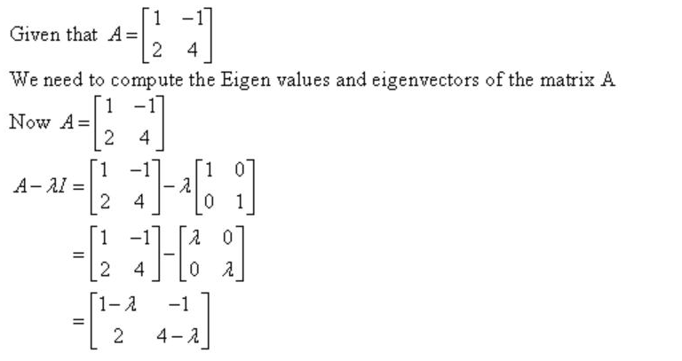
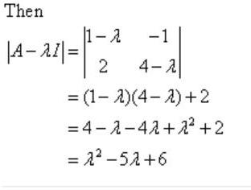
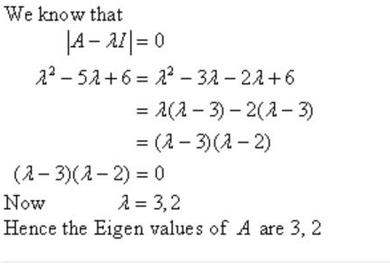
Problem 1 (solution)

Slide 4
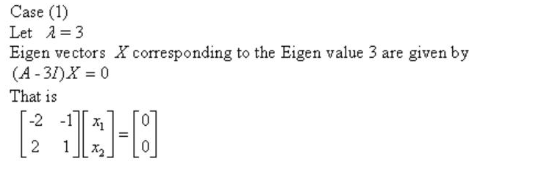
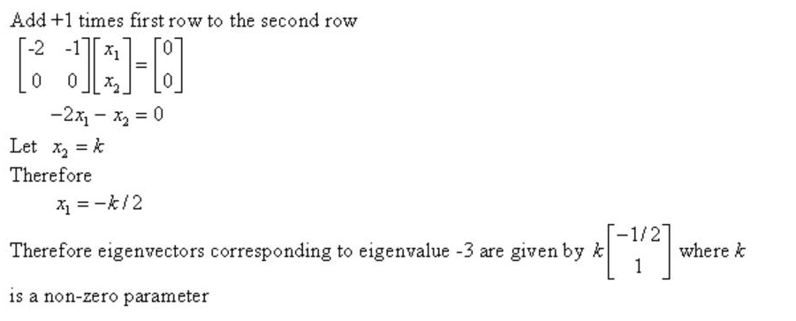

Slide 5
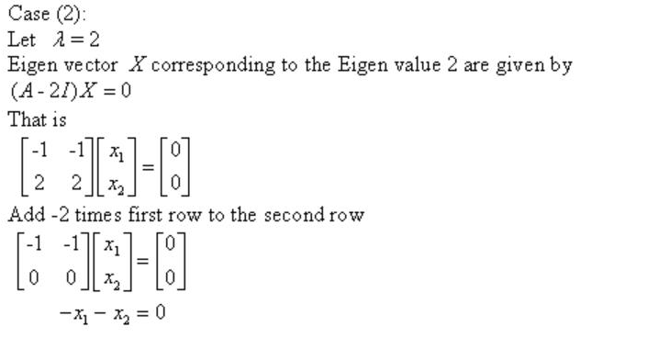
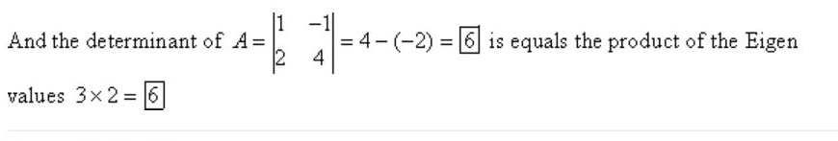
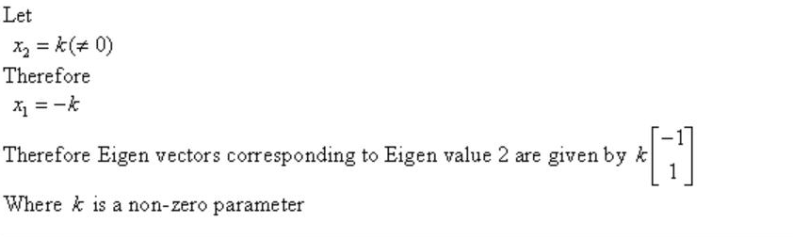
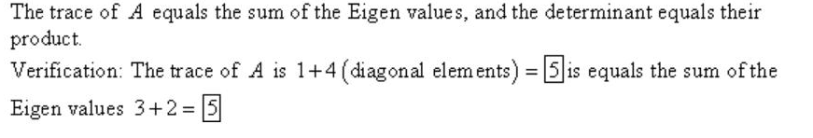

Slide 6
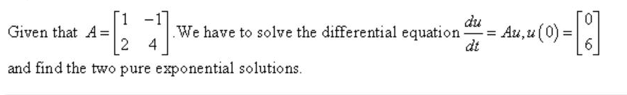
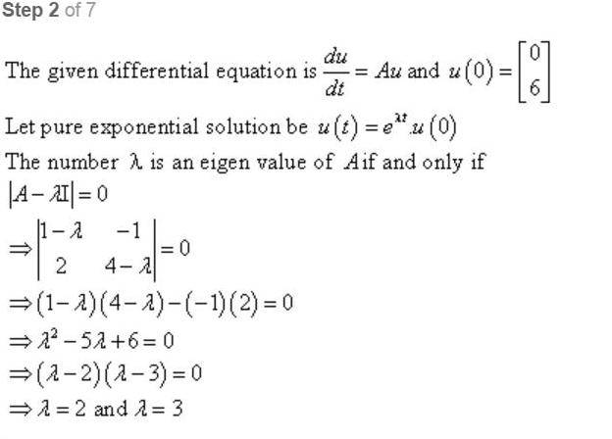
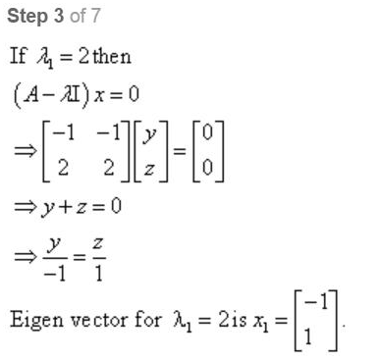
Problem 2

Slide 7
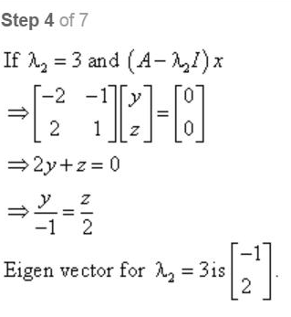
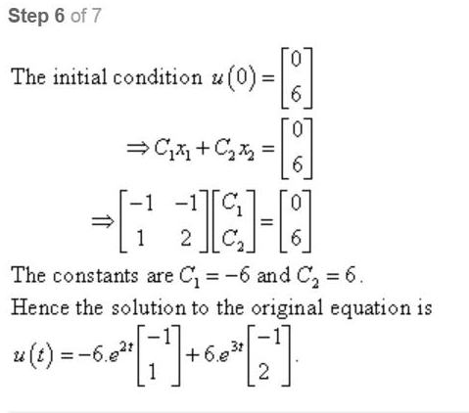
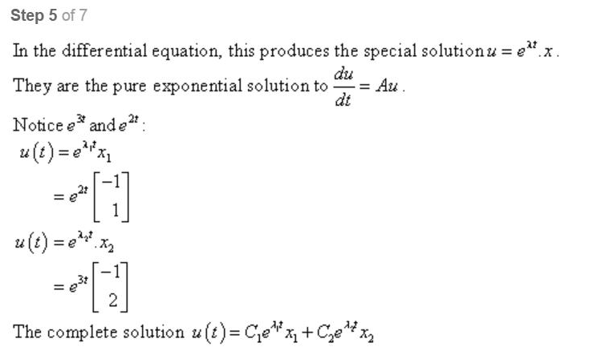
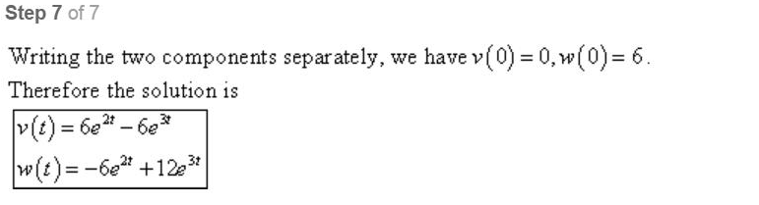

Slide 8
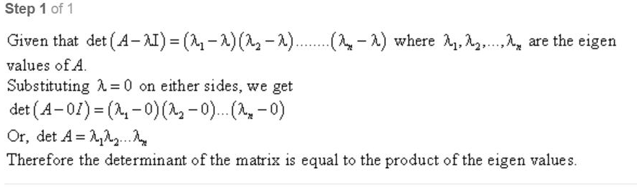
Problem 8(Solution)

Slide 9
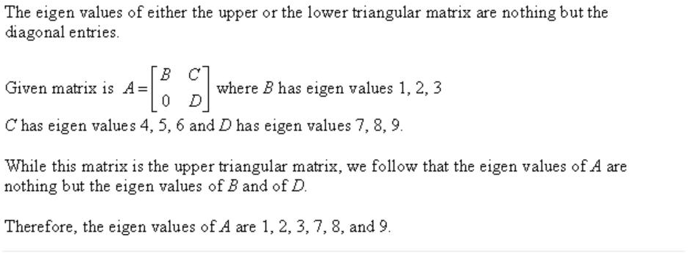
Problem 13 (Solution)

Slide 10
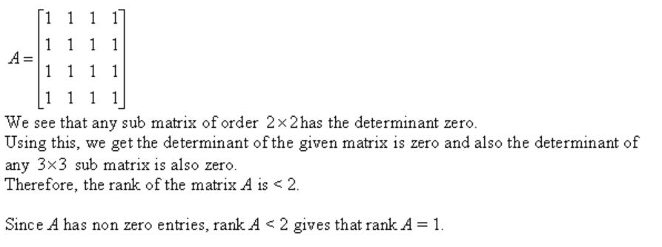
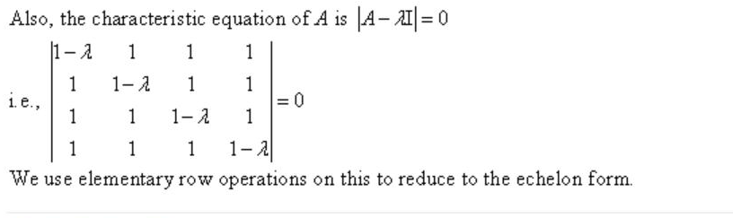
Problem 14 (Solution)

Slide 11
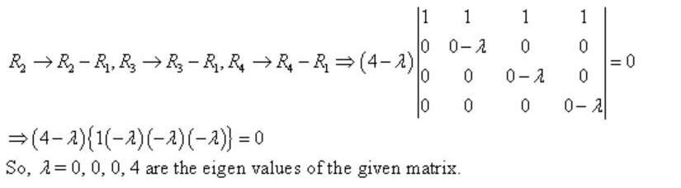
Remember that |(A-λI) | give a polynomial after simplification and that polynomial is known as characteristic polynomial. It means that the root/solution of characteristic polynomial is known as eigen value.

Slide 12
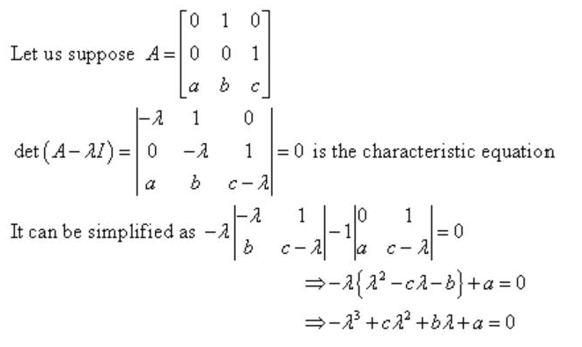
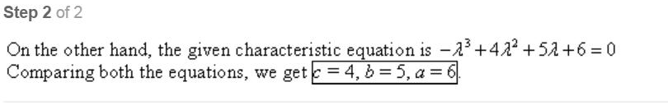
Problem 17(solution)

Slide 13
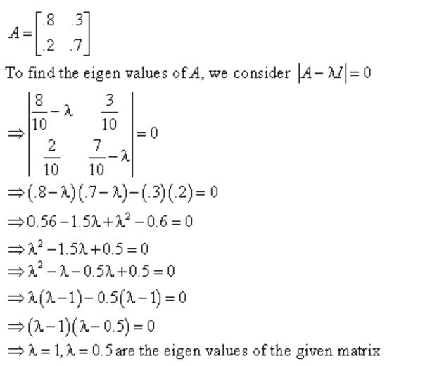
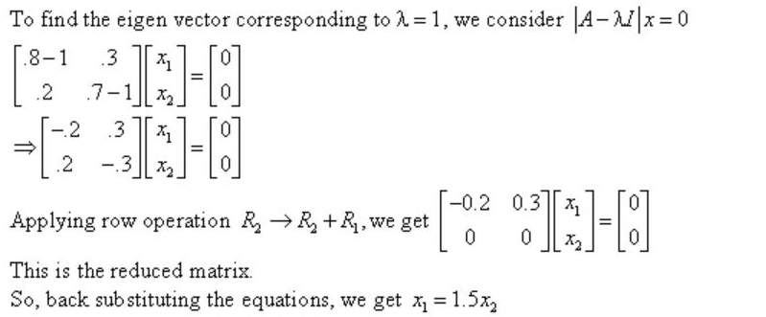
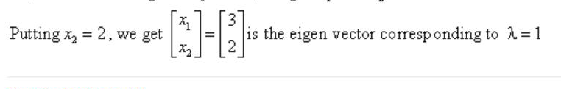
Problem 19 (Solution)

Slide 14
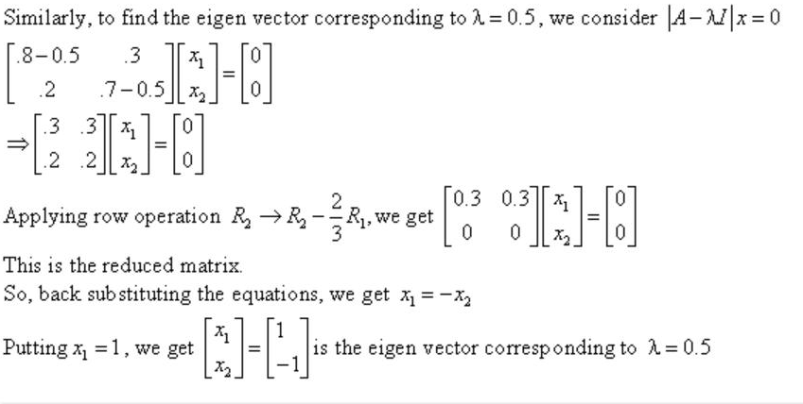
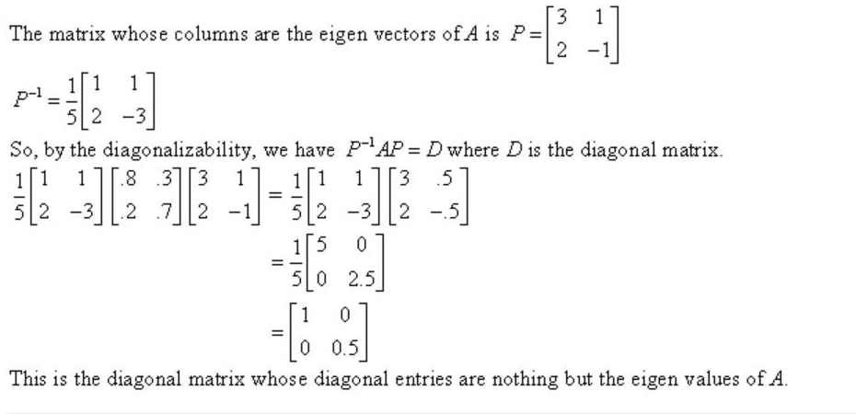

Slide 15
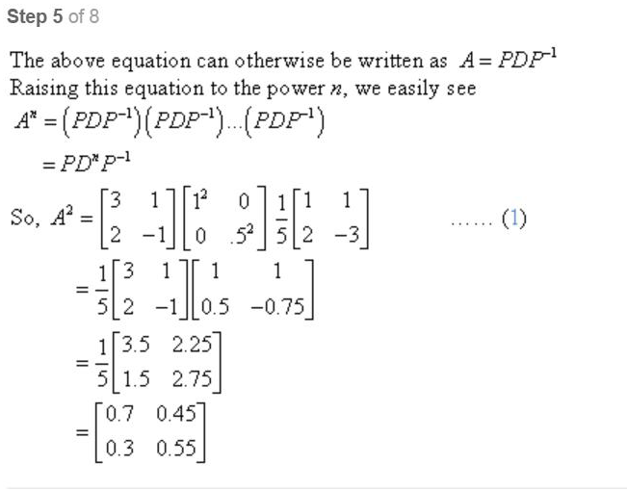
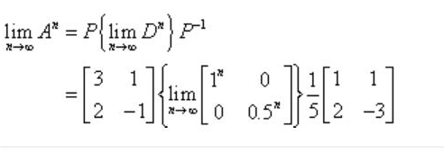
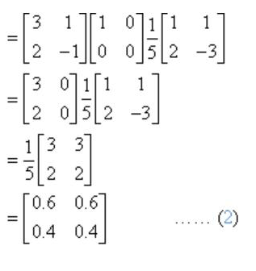

Slide 16
Do all the similar problems by yourself.
Summary:
Ax=λx (λ=eigen value and x=eigen vector)
Solve |(Ax- λI) |=0 to calculate eigen value. You can apply elementary operation on this equation to compute its eigen values and do not apply elementary operation over the given matrix A. solve Ax= λx to get the corresponding eigen vector.
The determinant is product of eigen values and trace is equal to the sum of eigen values.
You must remember these three steps in your mind in a good way so that you can not face any difficulty.

